Slide 1
Design Pattern: “Fluent Interface”
Leandro da costa gonçalves

Slide 2


Eric Evans e Fowler

Slide 3
The Fluent Interface Pattern
One of many design patterns that can contribute to a better code base
Fluent Interfaces makes the code easier to read and easier to use due to a simpler API that requires less code
Consists of 2 principles:
Method chaining - Traditional code requires one line per command, method chaining allows multiple commands per line
More readable API – The code can be read like a sentence. Optional as it requires more typing due to longer names and more code to write

Slide 4
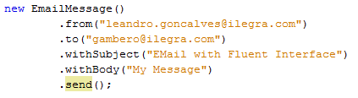
More Readable

Slide 5
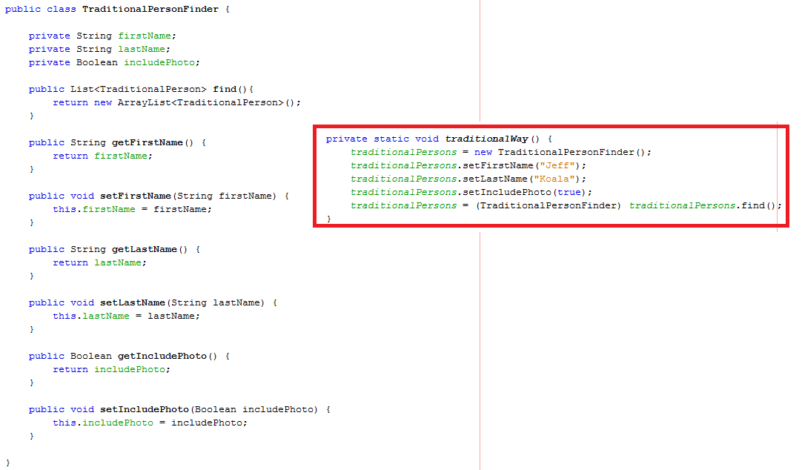
Traditional

Slide 6
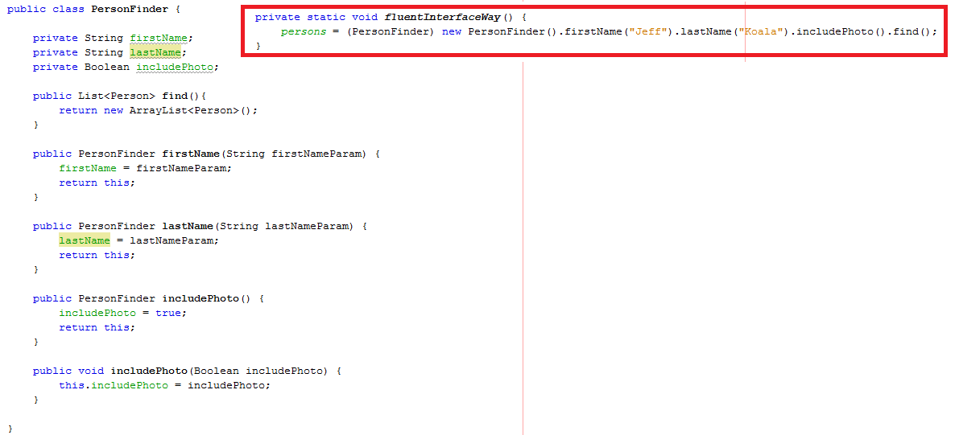
Fluent Interface

Slide 7
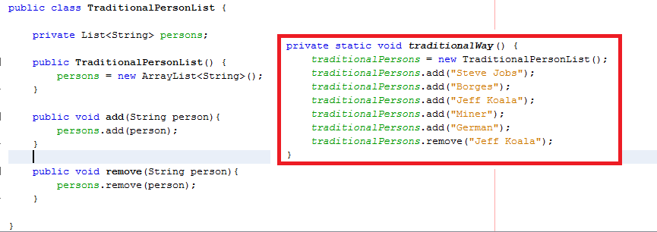
Traditional

Slide 8
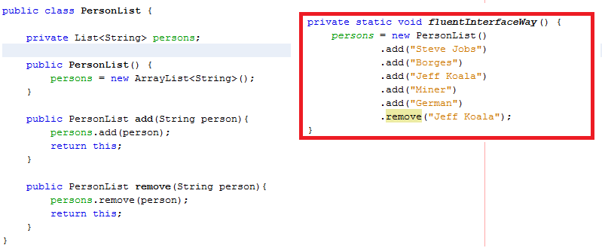
Fluent Interface

Slide 9
When to use Fluent Interfaces
Anywhere where it makes the code easier to read and easier to use
Typically in methods that are often invoked
Frameworks

Slide 10
Let's practice
Implement an algorithm to change one burned lamp.

